Slide 1
Structuring Inclusivity: South Africa’s Path to Peace
Deep structural problems cannot be solved without a transformation of relationships. And this requires a deliberate focus on process design.

Slide 2
Apartheid left South Africa deeply divided—defined by exclusion and racial domination. A small minority ruled over a majority that was silenced and shut out. The peace process was deliberately designed to change this: to bring all political actors into an inclusive shared political space.

Slide 3
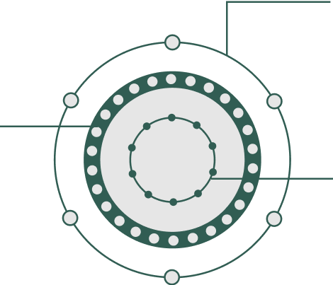
Managing Conflict through International Mediation
The negotiation process brought all political actors to the table. This created complexity. The process was structured to manage it. It introduced self-mediation mechanisms to break deadlocks, to build consensus and move negotiations forward. The negotiations led to a framework agreement endorsed by all the parties.
Technical Committees
Multi party negotiating process
Mechanism to generate options through the one-text methodology Each composed of 5-6 non-party political experts trusted by all the parties
Negotiating Council
All party negotiating forum 26 parties with 2 negotiators from each party with at least 1 woman + 2 advisers
Planning Committee
Deadlock breaking & consensus
building mechanism
10 negotiators appointed by
agreement of all parties based
on their ability to ﬁnd consensus

Slide 4

Widening Inclusivity & Drafting the Constitution
+2M of South
Africans
Parties outside
the assembly
Elected
Constitutional
Assembly
Following the endorsement of the framework agreement and the first elections, the Constitutional Assembly invited all South Africans to contribute in shaping the final constitution. The result was a Constitution that every South African could trust and see themselves in.
Constitution

Slide 5

A Process of Transformation: A Self-Mediated Journey
The peace process unfolded in three deliberate stages, each building on the last and giving every political actor and every South African a role and a voice.
1991
The National Peace Accord
1994
1996
Created national, regional, and local structures to manage violence and support dialogue.
Multi-Party
Negotiation Process
The Constitutional
Assembly
Negotiated the framework for a new democratic South Africa and led to the ﬁrst democratic elections.
Negotiated through the
Constitutional Assembly
with input from millions
of South Africans.

Slide 6
South Africa’s process was more than a negotiation. It was a process of self-mediation that structured inclusivity and transformed relationships, becoming a lasting symbol of South Africa’s transition from apartheid to democracy.

