Slide 1
Internationally Mediated Peace: Bosnia-Herzegovina’s Path to Peace
How the peace process ended the war through coercive diplomacy but left unresolved divisions in its wake.

Slide 2
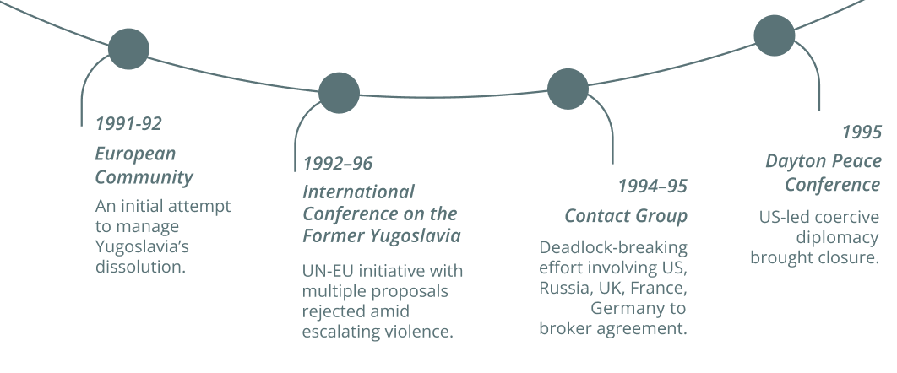
Managing Conflict through International Mediation
As the war deepened, the world watched with alarm and Bosnia became a major international concern. Fears of regional instability and the scale of humanitarian atrocities, drove international actors to try to mediate an agreement. Years of international efforts failed until the US led a final, coercive push.

Slide 3
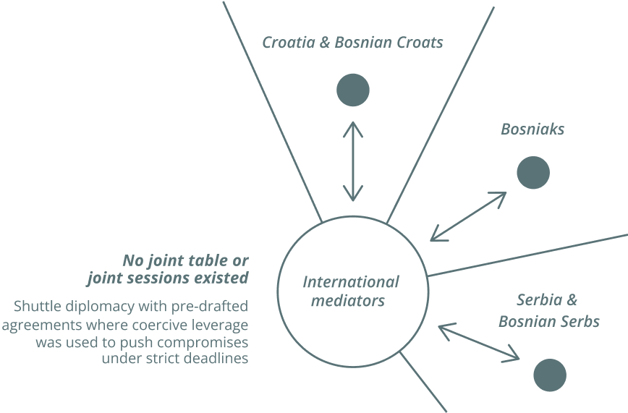
From War to Imposed Peace
At Dayton, the US used coercive diplomacy, including the threat of military action, to impose an agreement that would end the war.

Slide 4

The process brought an immediate halt to violence. It was designed to stop the war not to resolve the underlying conflict. Mediated and enforced by international actors, it was shaped outside Bosnia with no space for local ownership.

Slide 5
A Fragile Peace, Unresolved Conflict
The Dayton Peace Accords contained the violence but the relationships at the heart of the conflict were never transformed.
1
2
3
Ended the war, not the conflict
Internationally owned & led, not built from within
Formalised peace without political reconciliation

Slide 6

Three decades on, peace holds. But the system remains fragile, shaped by mistrust and competing visions of the future.

