Slide 1
Addressing the totality of relationships: Northern Ireland Path to Peace
How redesigning the process around three key relationships transformed the conflict into lasting institutions

Slide 2

Decades of violence and mistrust reflected the depth and complexity of division in Northern Ireland. Early peace efforts failed. It was only when the process was redesigned to include all actors, to address all issues and all sets of relationships agreement was possible.

Slide 3
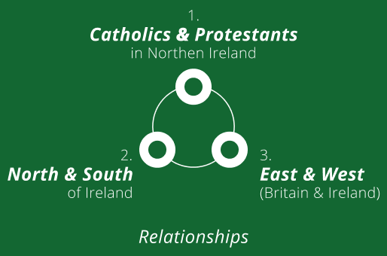
A Conflict of Relationships
From the outside, the conflict may have looked like a territorial dispute. But at its core, it was about three deeply contested relationships: within Northern Ireland, across the island, and between Ireland and Britain.

Slide 4
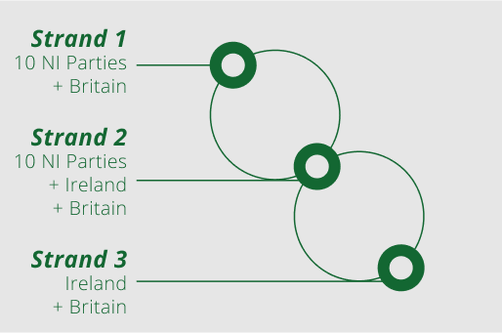
The Three Strands
Each of these relationships became a strand in the negotiations.
The talks were structured to reflect this complexity.

Slide 5
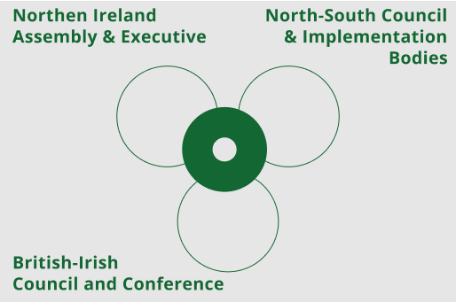
Living Architecture:
Resilient Institutions
The Agreement created institutions under each of the three strands—each designed to support and repair the relationships at the heart of the conflict.

Slide 6
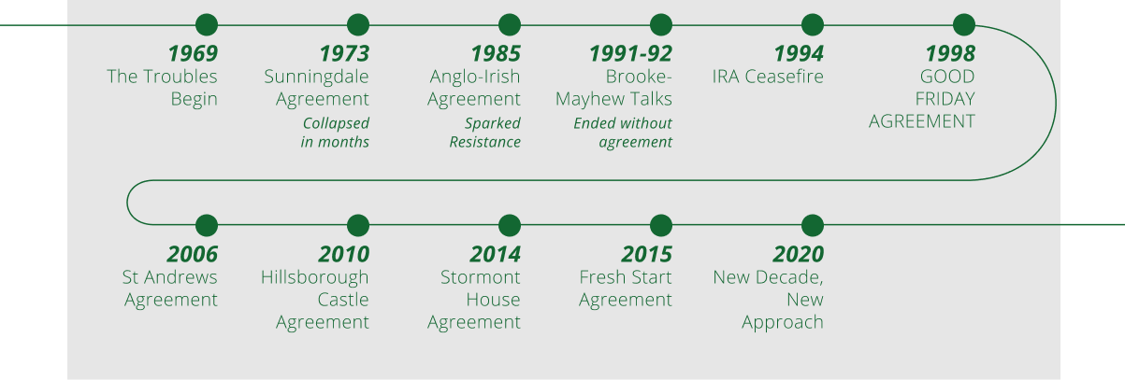
Timeline: From Deadlock to Agreement
The Agreement was the product of successive approximations. Each new process built on the lessons of the one before.

Slide 7

More than 25 years later, the Good Friday Agreement remains a robust and resilient construct.
It is the story of a process that has found a way to endure and prevail. The robustness built into the structures and DNA of the process—including post-agreement—has enabled it to absorb the shocks, setbacks, problems, and pauses that have inevitably occurred.

